Slide 1
Fundamentals of CI/CD
CI/CD Stand for Continuous Integration / Continuous Deployment
Continuous Integration
It merge all developers' working copies to a shared mainline several times a day. It's the process of "Making". Everything related to the code fits here, and it all culminates in the ultimate goal of CI
Compile
Unit Test
Static Analysis
Dependency vulnerability testing
Store artifact

Slide 2
Continuous Deployment
A software engineering approach in which the value is delivered frequently through automated deployments. Everything related to deploying the artifact fits here. It's the process of "Moving" the artifact from the shelf to the spotlight.
Creating infrastructure
Provisioning servers
Copying files
Promoting to production
Smoke Testing
Rollbacks

Slide 3
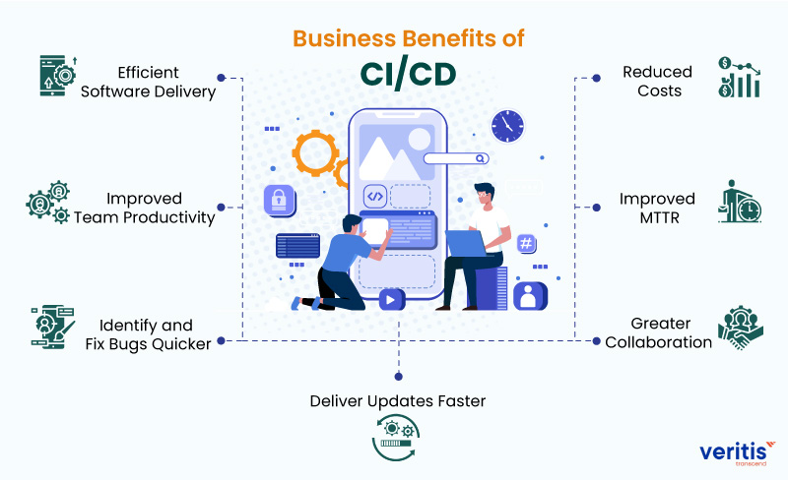
Benefits of CI/CD
Faster time to market
Reduced risk
Shorter review time
Better code quality
Smoother path to production
Faster bug fixes
Efficient infrastructure
Measurable progress
Tighter feedback loops
Collaboration and communication
Maximized creativity

Slide 4
Technical benefits Business benefits
Catch Compile Errors After Merge
Catch Unit Test Failures
Detect Security Vulnerabilities
Automate Infrastructure Creation
Automate Infrastructure Cleanup
Faster and More Frequent Production Deployments
Deploy to Production Without Manual Checks
Automated Smoke Tests
Automated Rollback Triggered by Job Failure
Less developer time on issues from new developer code
Less bugs in production and less time in testing
Prevent embarrassing or costly security holes
Less human error, Faster deployments
Less infrastructure costs from unused resources
New value-generating features released more quickly
Less time to market
Reduced downtime from a deploy-related crash or major bug
Quick undo to return production to working state

Slide 5
Conclusion
The benefits of an automated CI/CD pipeline range from practical considerations like code quality and rapid bug fixes, to ensuring you’re building the right thing for your users and improving your entire software development process.
Despite the name DevOps suggesting a focus on developer and operations teams, building a CI/CD pipeline provides an opportunity for collaboration across a whole range of functions. By streamlining the steps to release your product, you provide your team with more insights into how your product is used and free up individuals’ time so they can focus on innovation.

